Slide 1



Slide 2
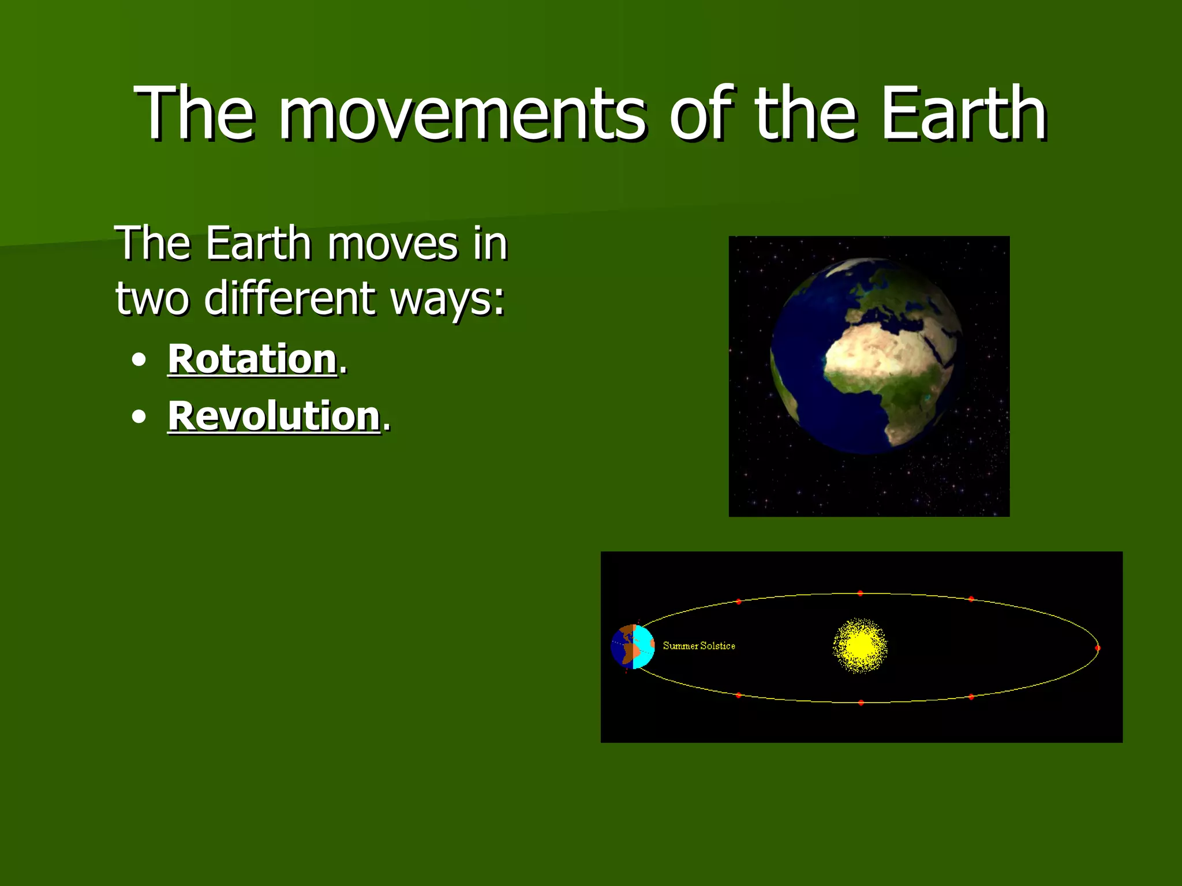
MOVEMENTS OF EARTH

Slide 3
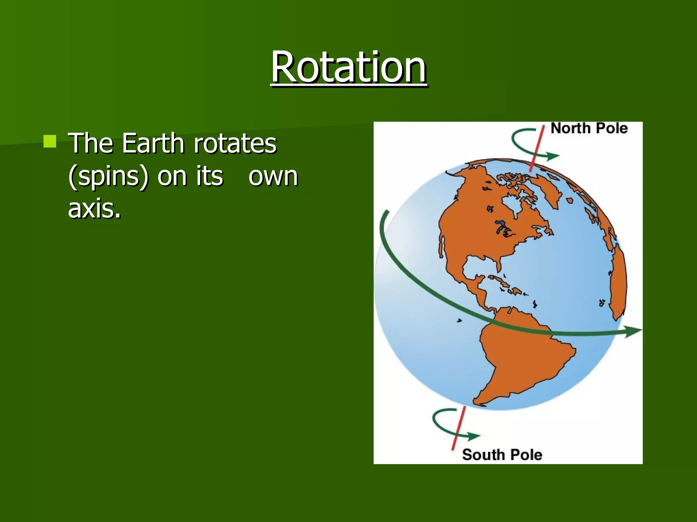
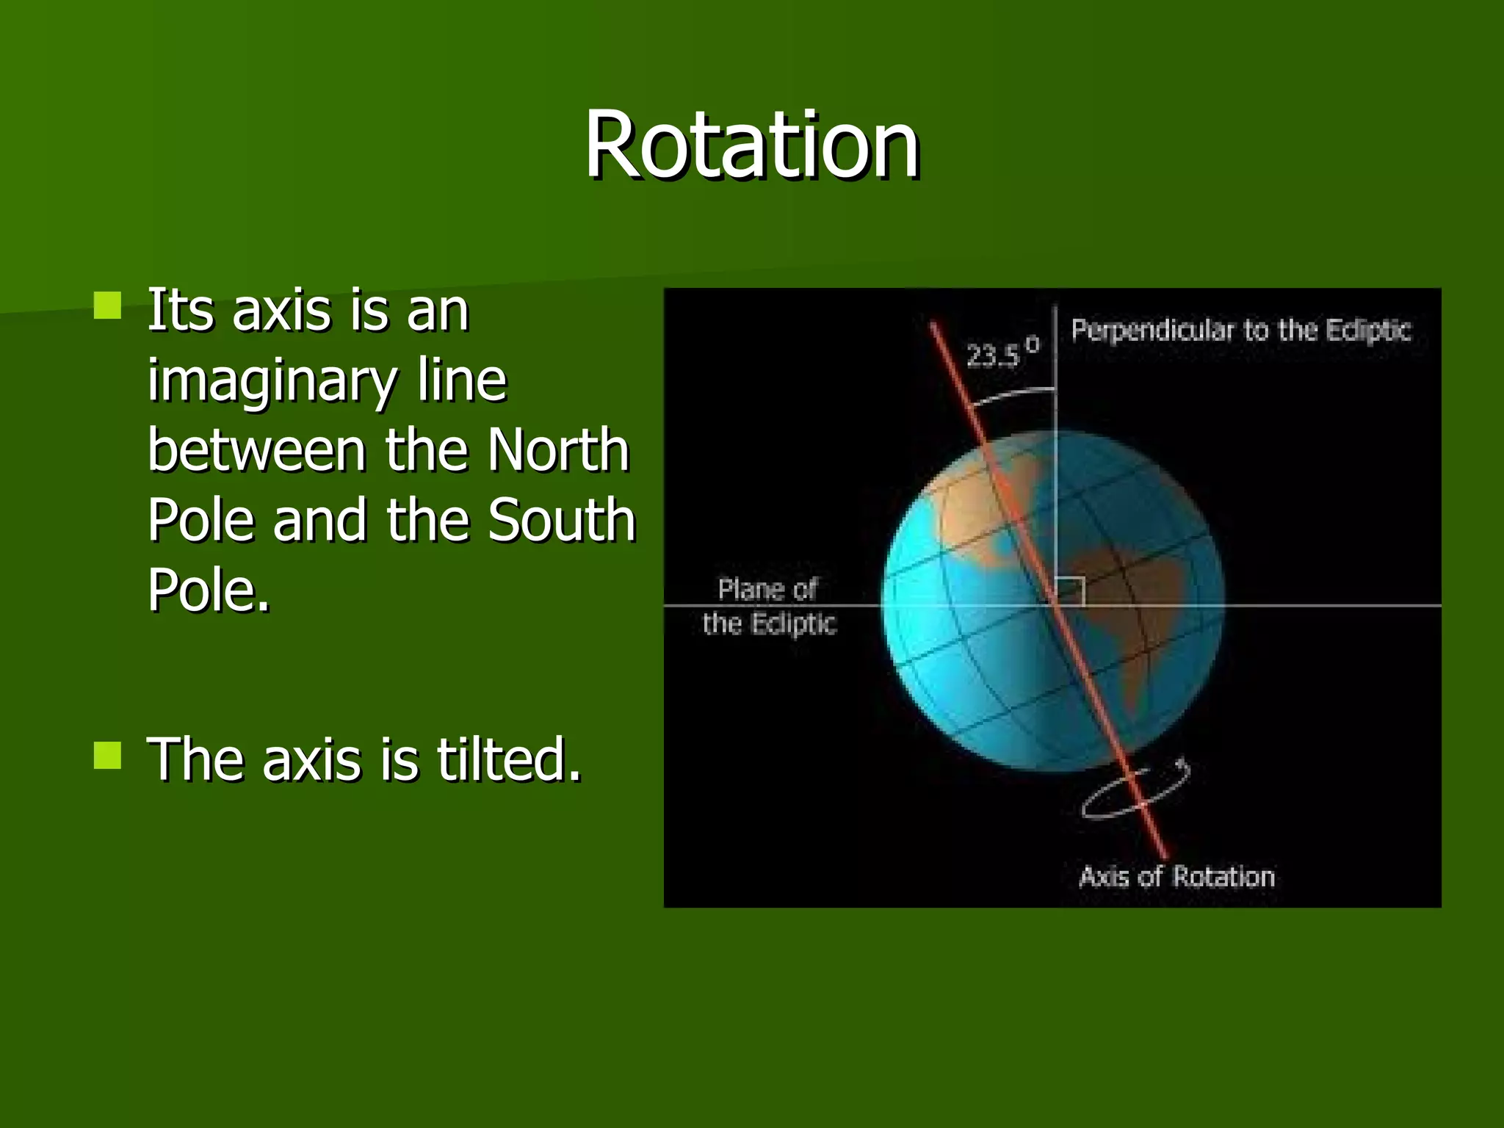
ROTATION

Slide 4
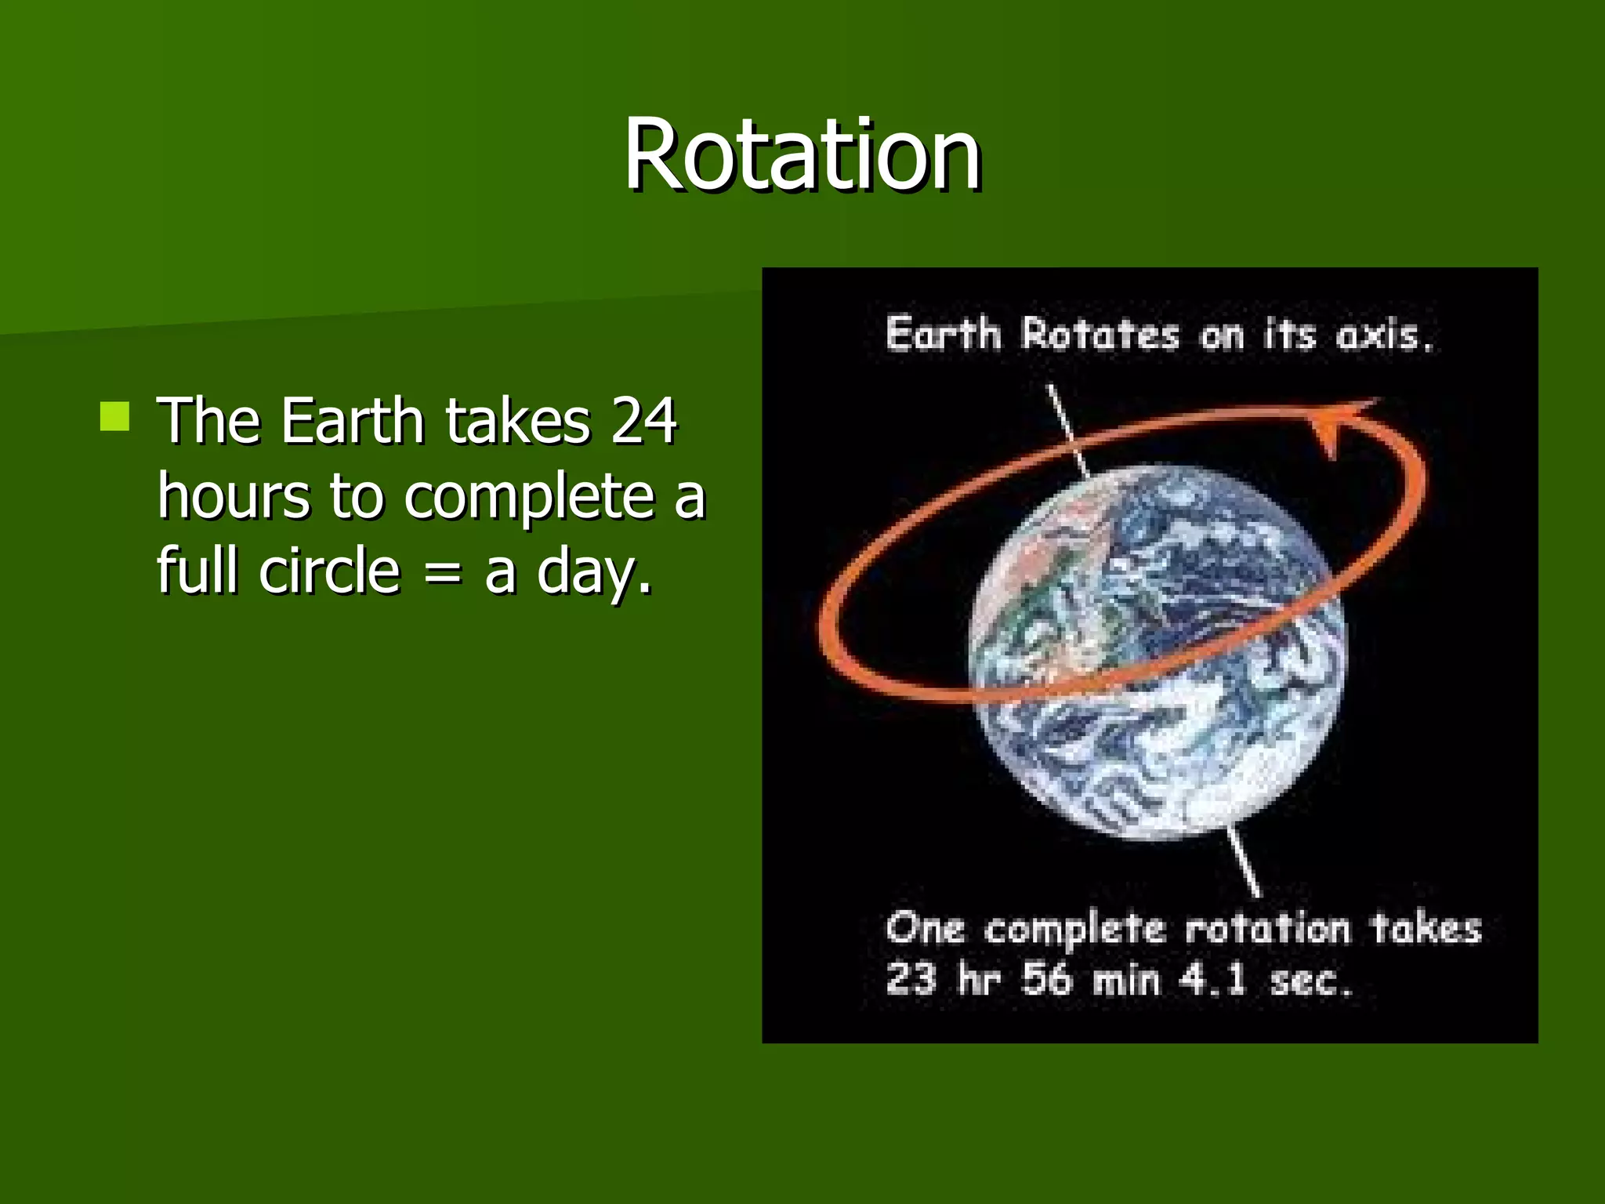
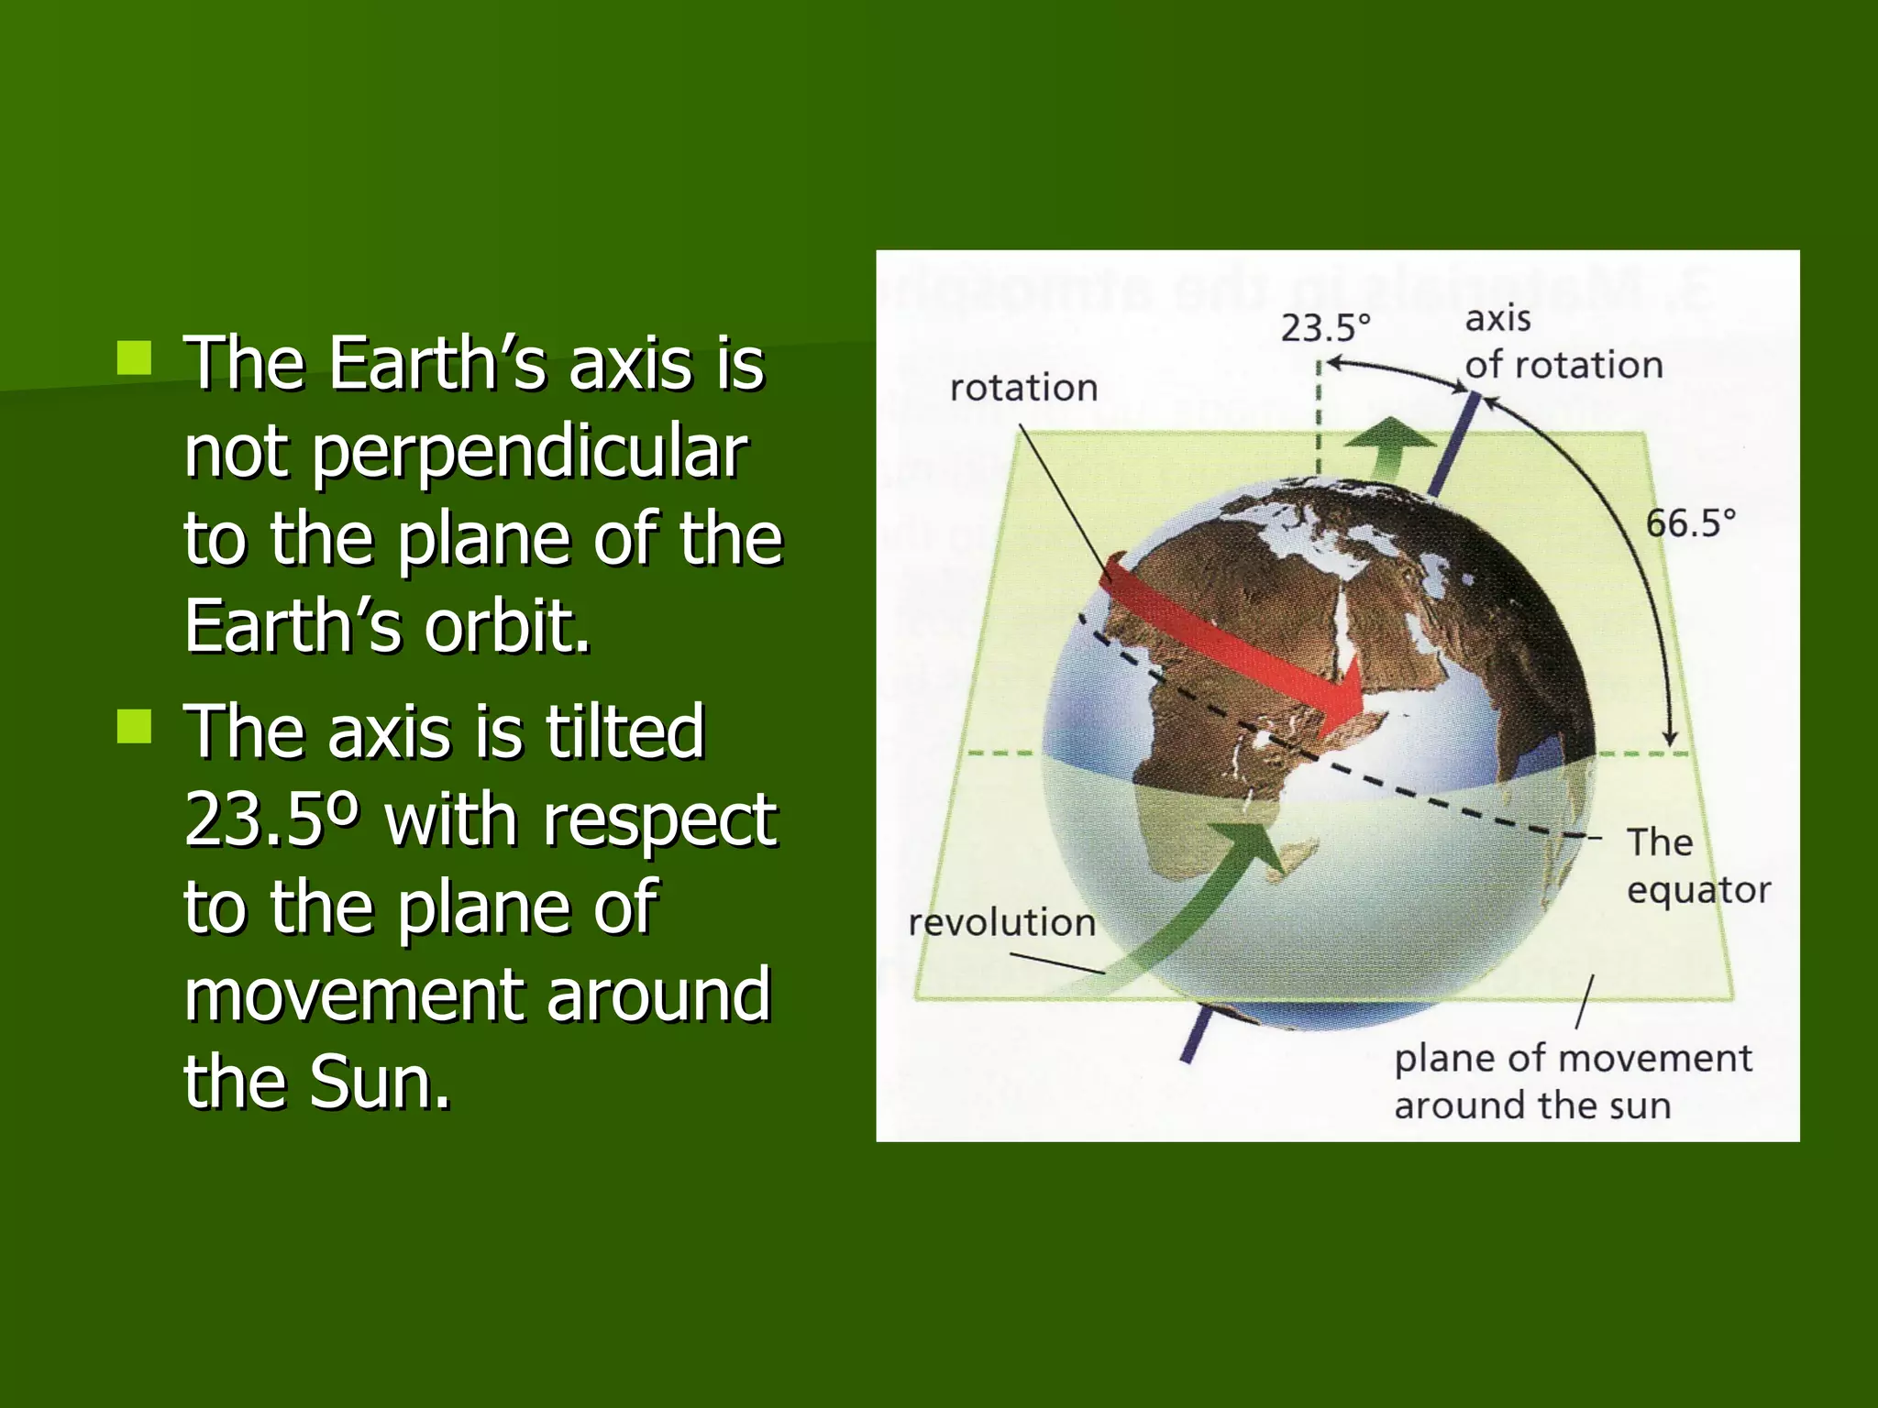
Movements of Earth /Social/N Karunambigai//SNS ACADEMY

Slide 5
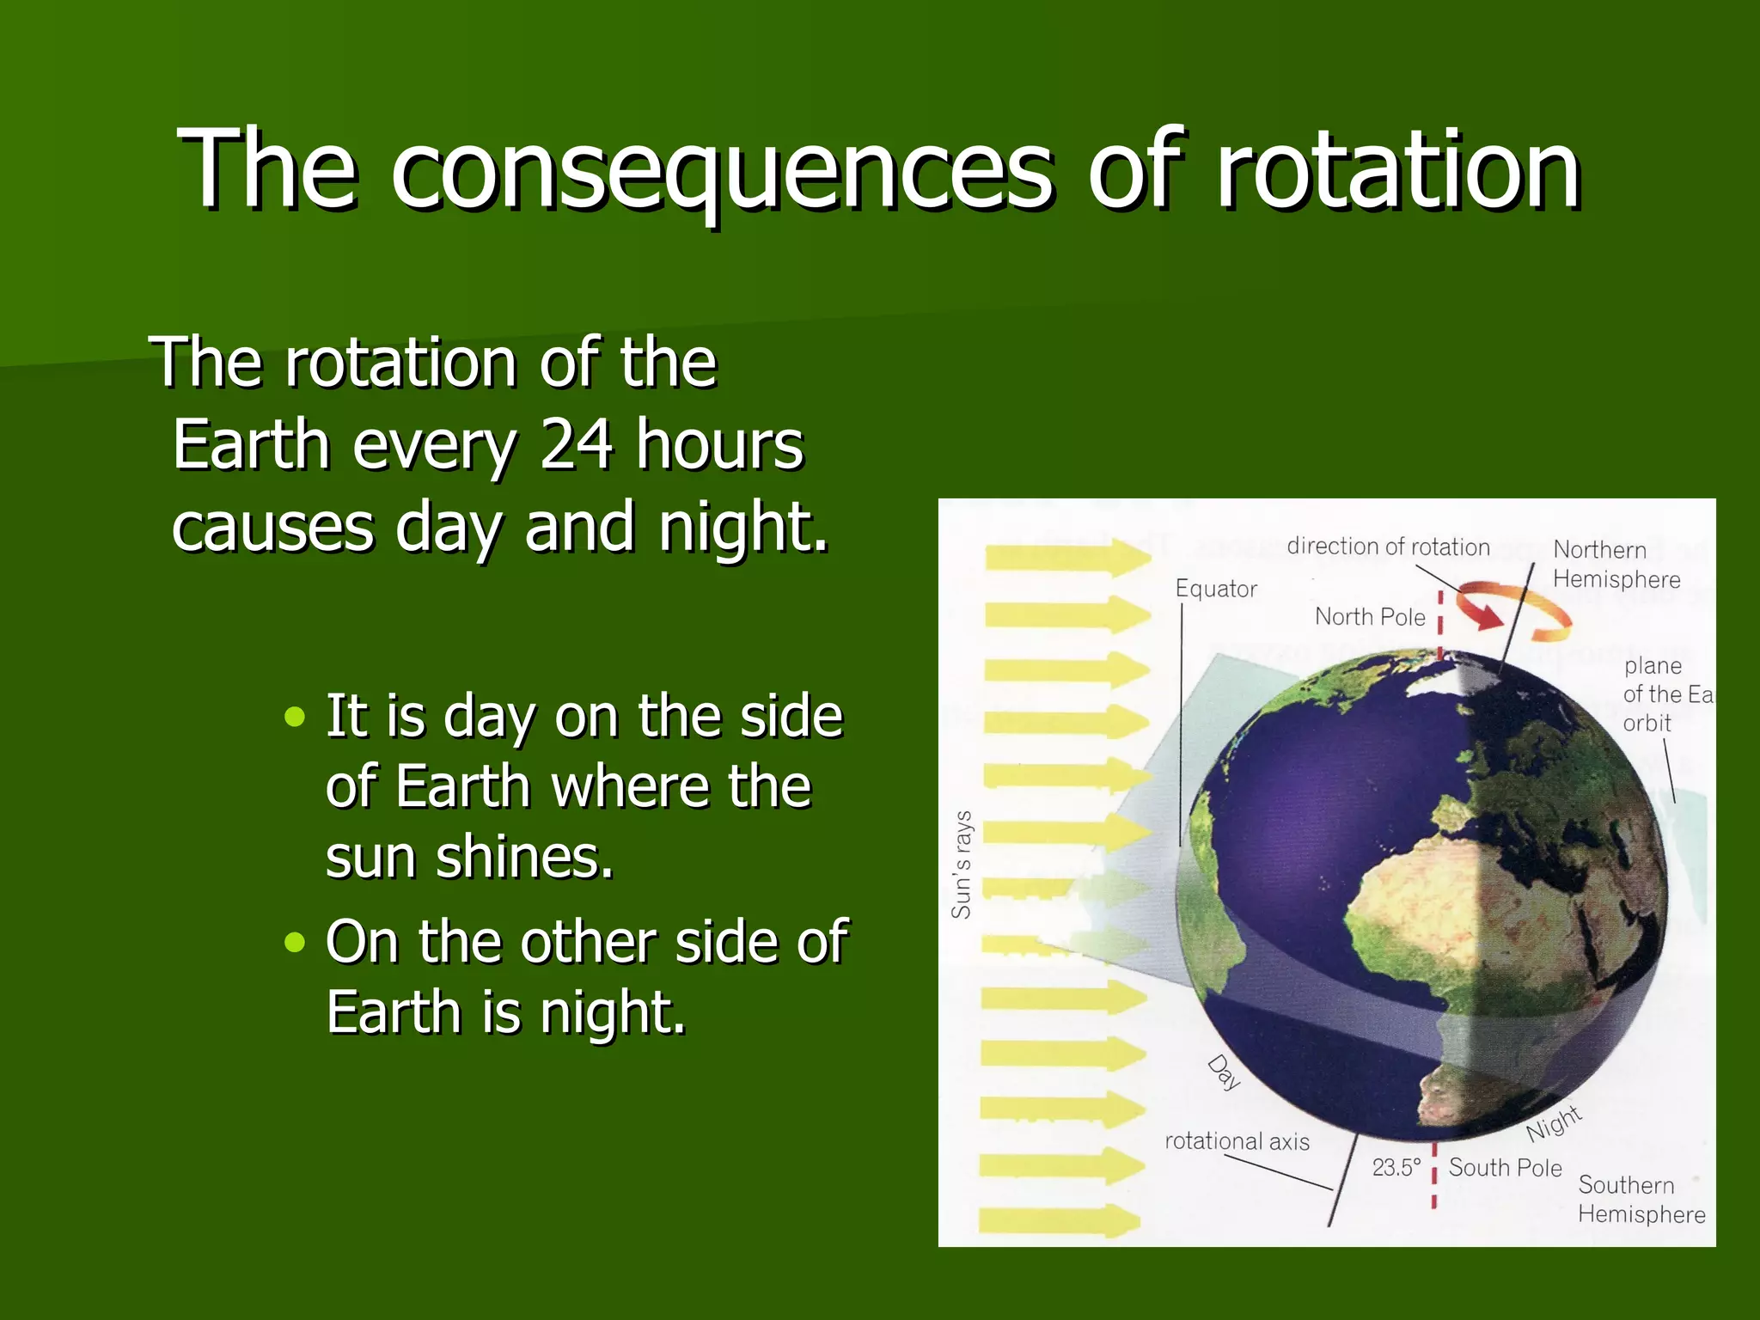

Slide 6
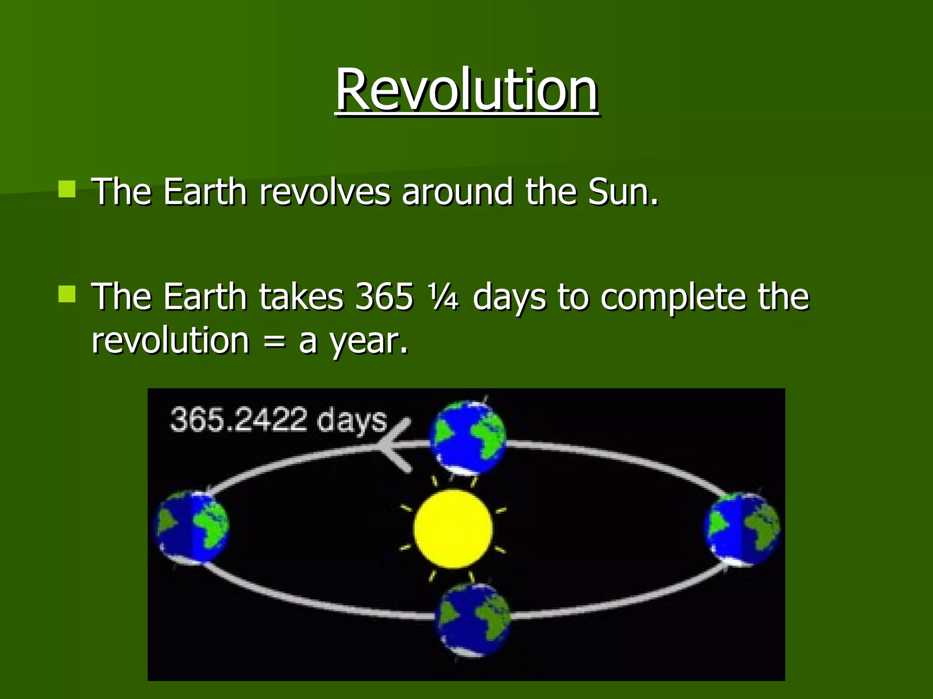
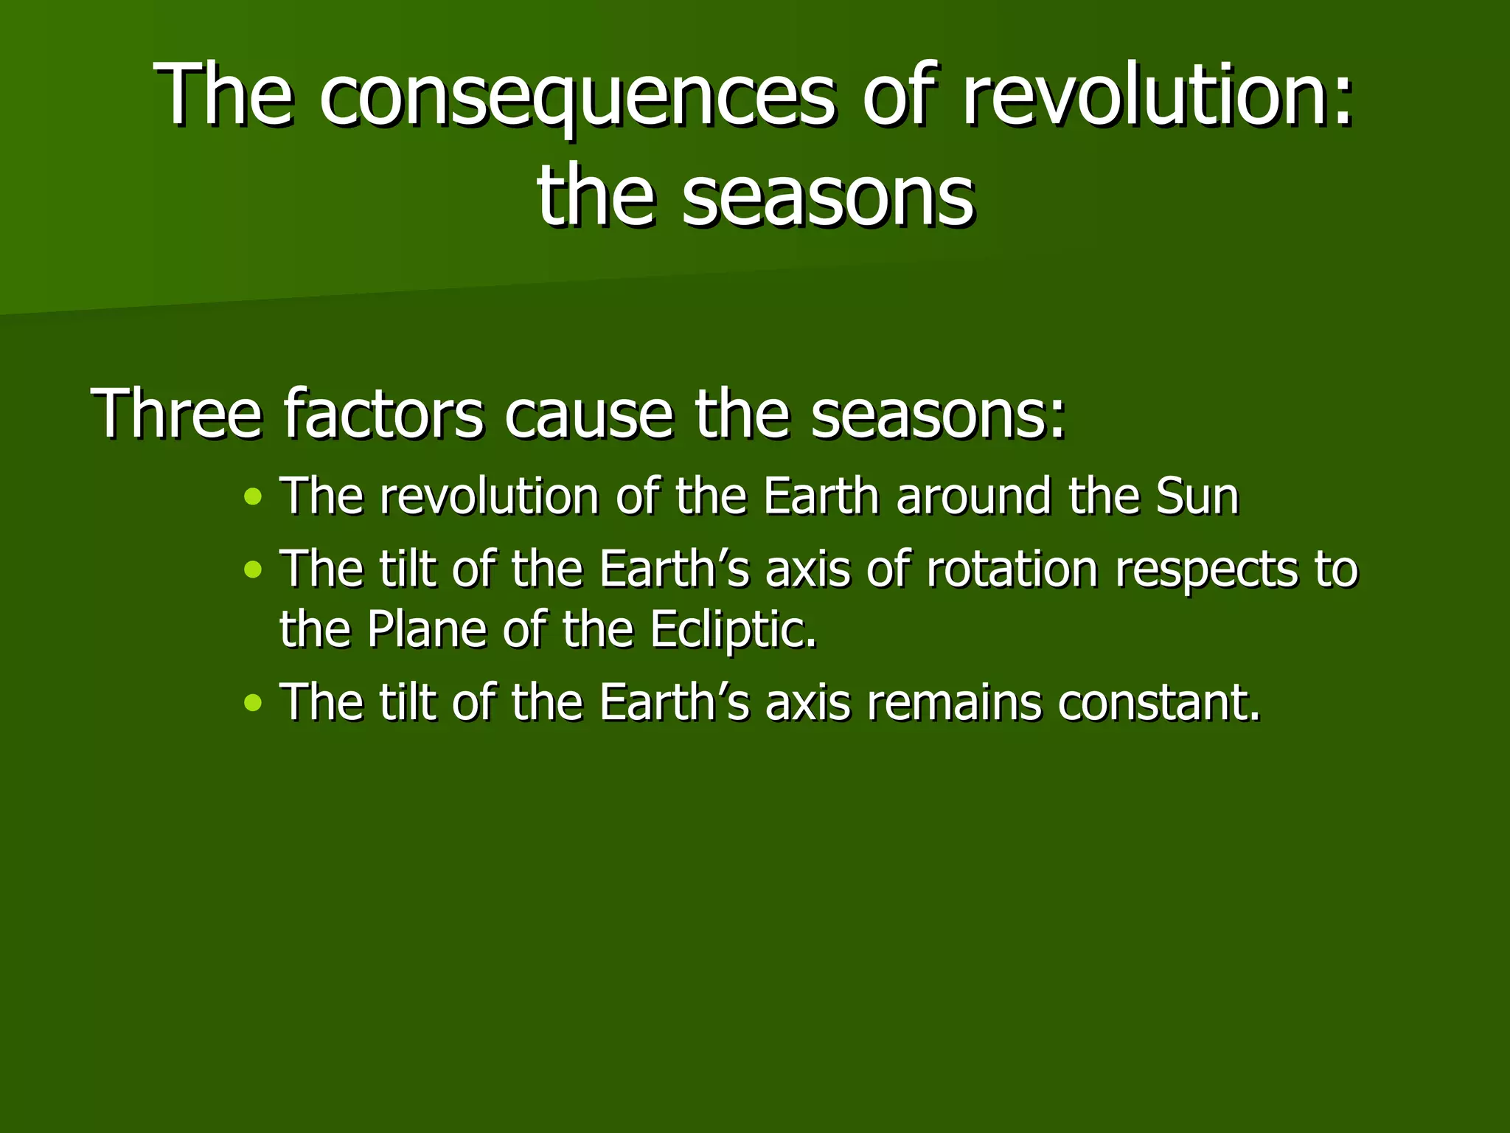
REVOLUTION

Slide 7
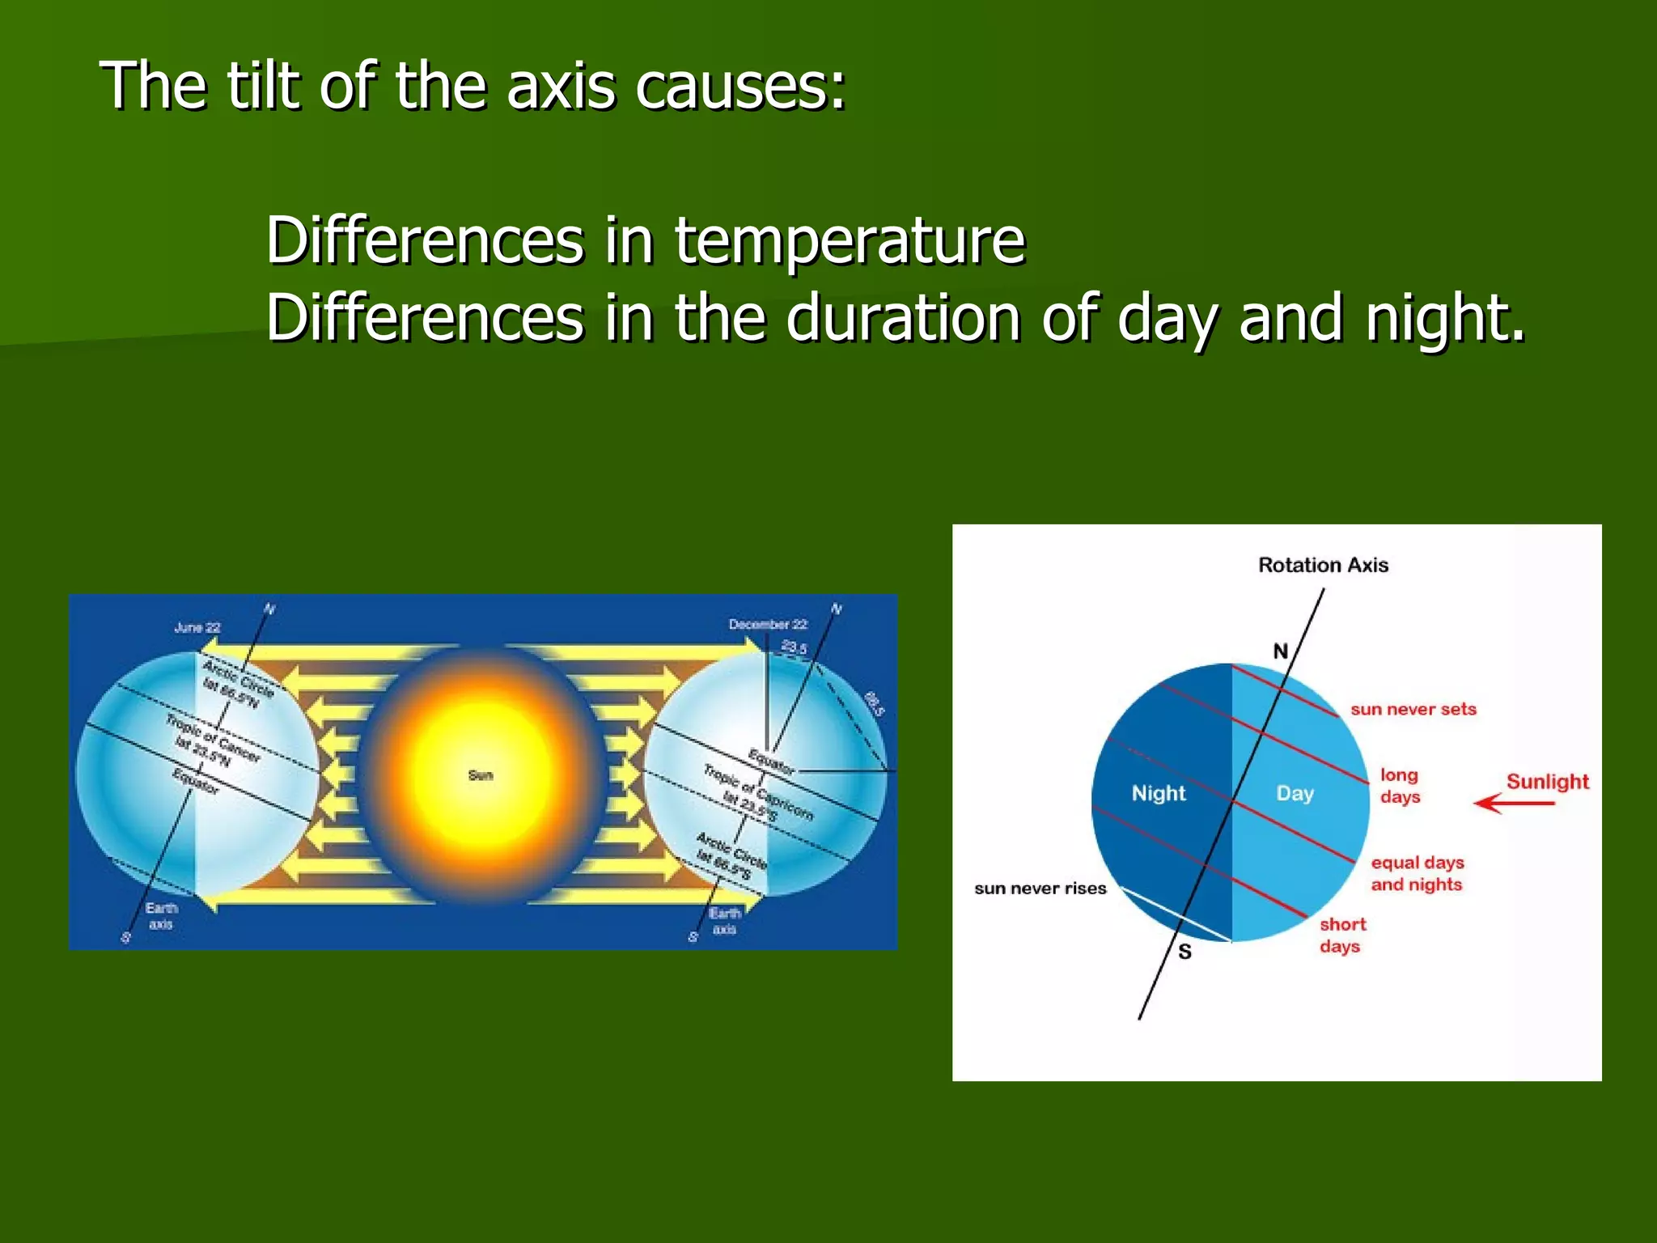
Movements of Earth/Karunambigai/Social/SNS ACADEMY

Slide 8
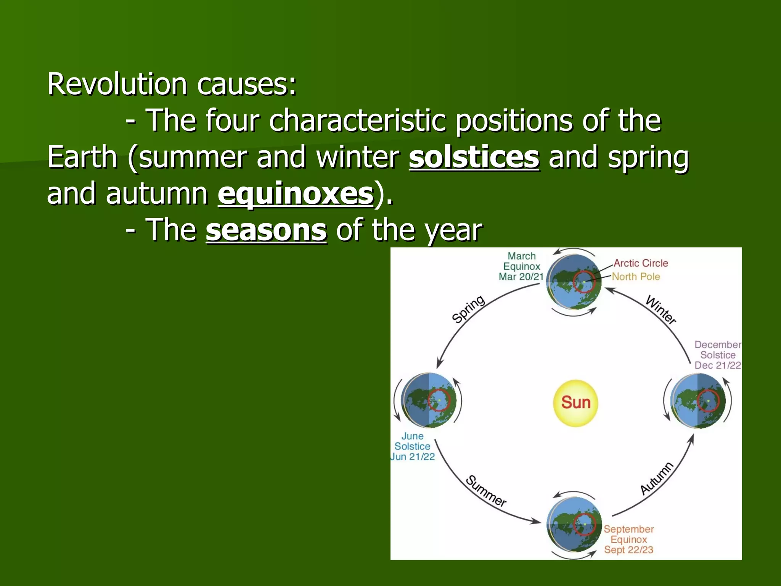

Slide 9
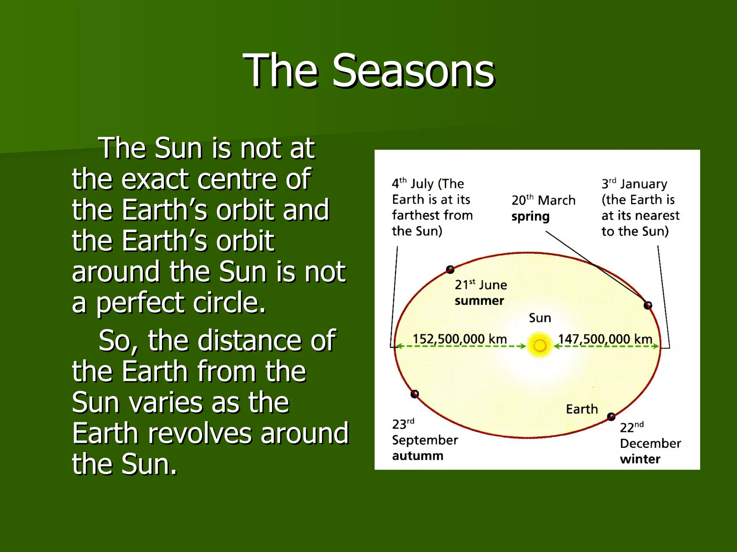
SEASONS

Slide 10
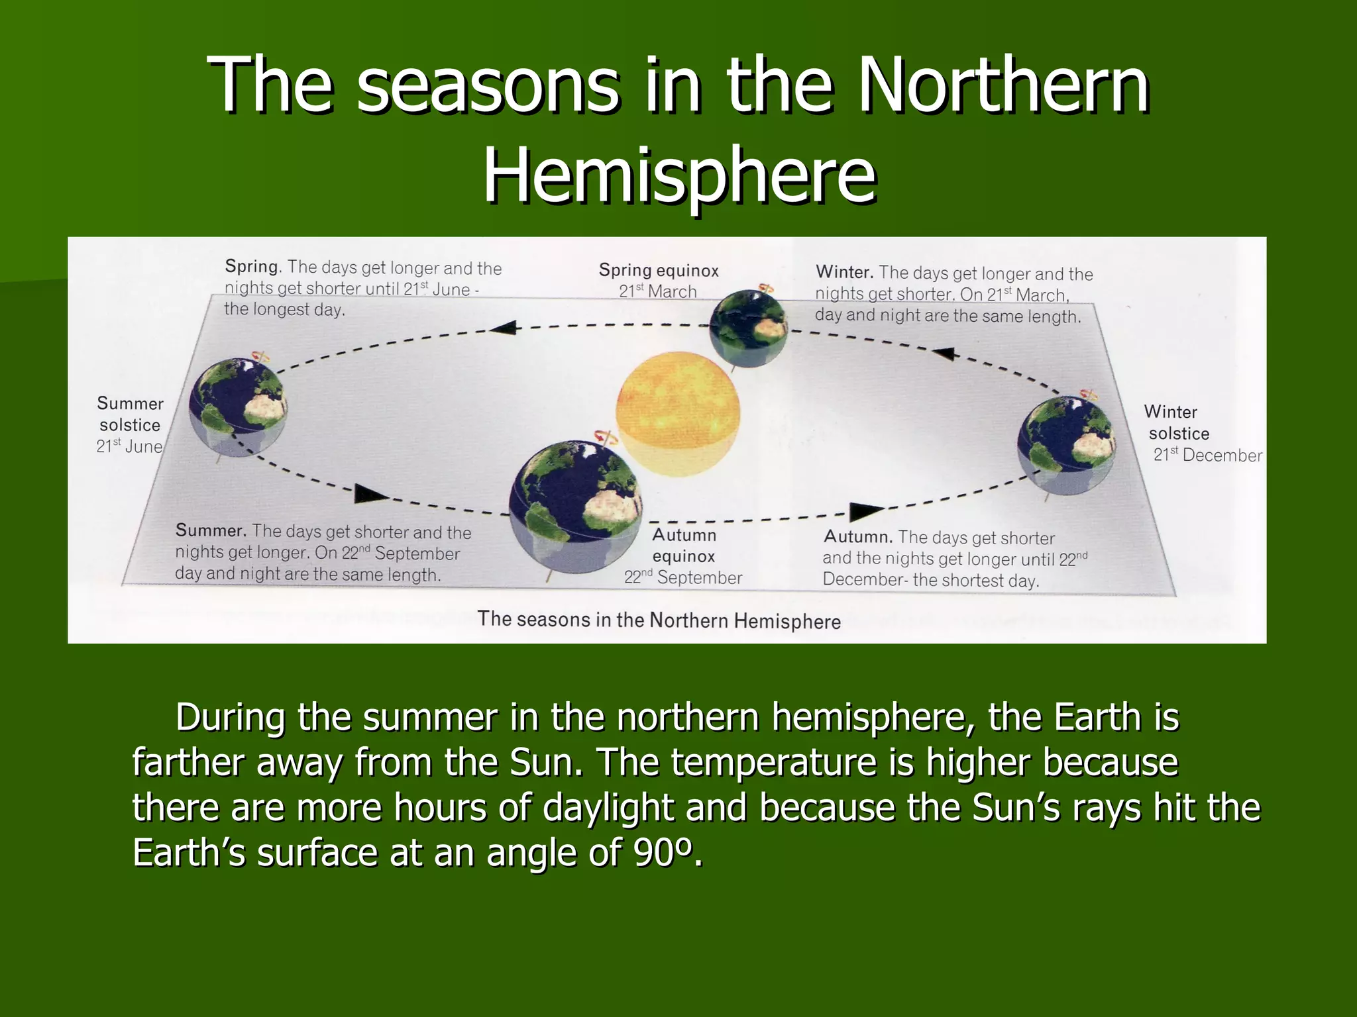

Slide 11
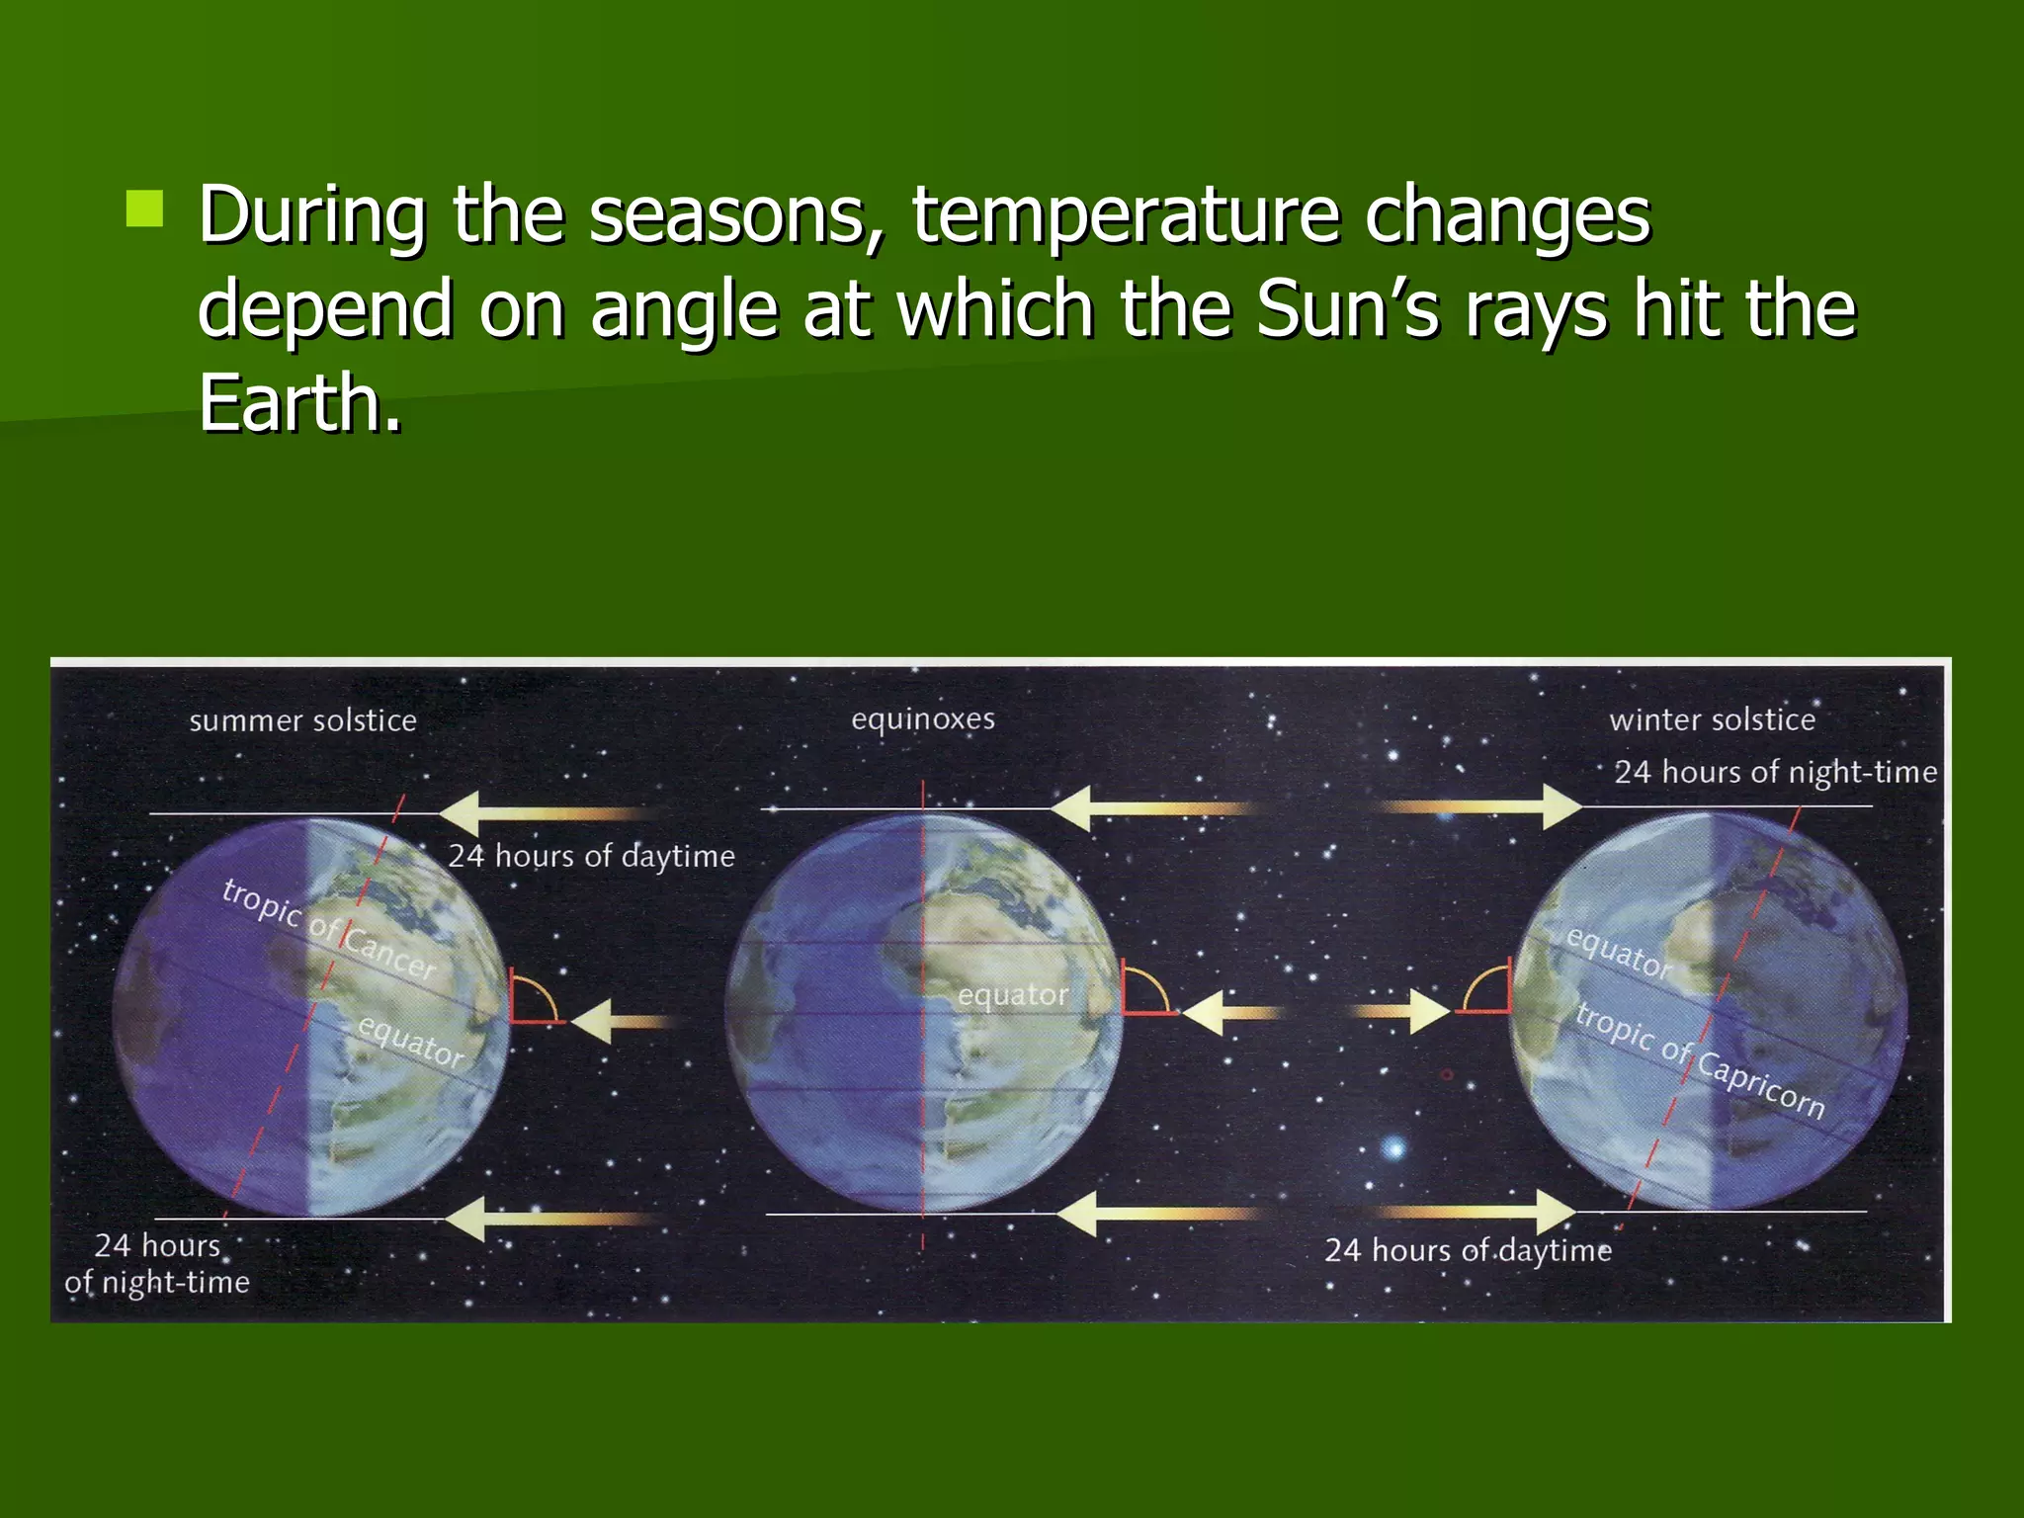
SEASONS
Movements of Earth/Social/NKarunambigai/SNS ACADEMY

Slide 12
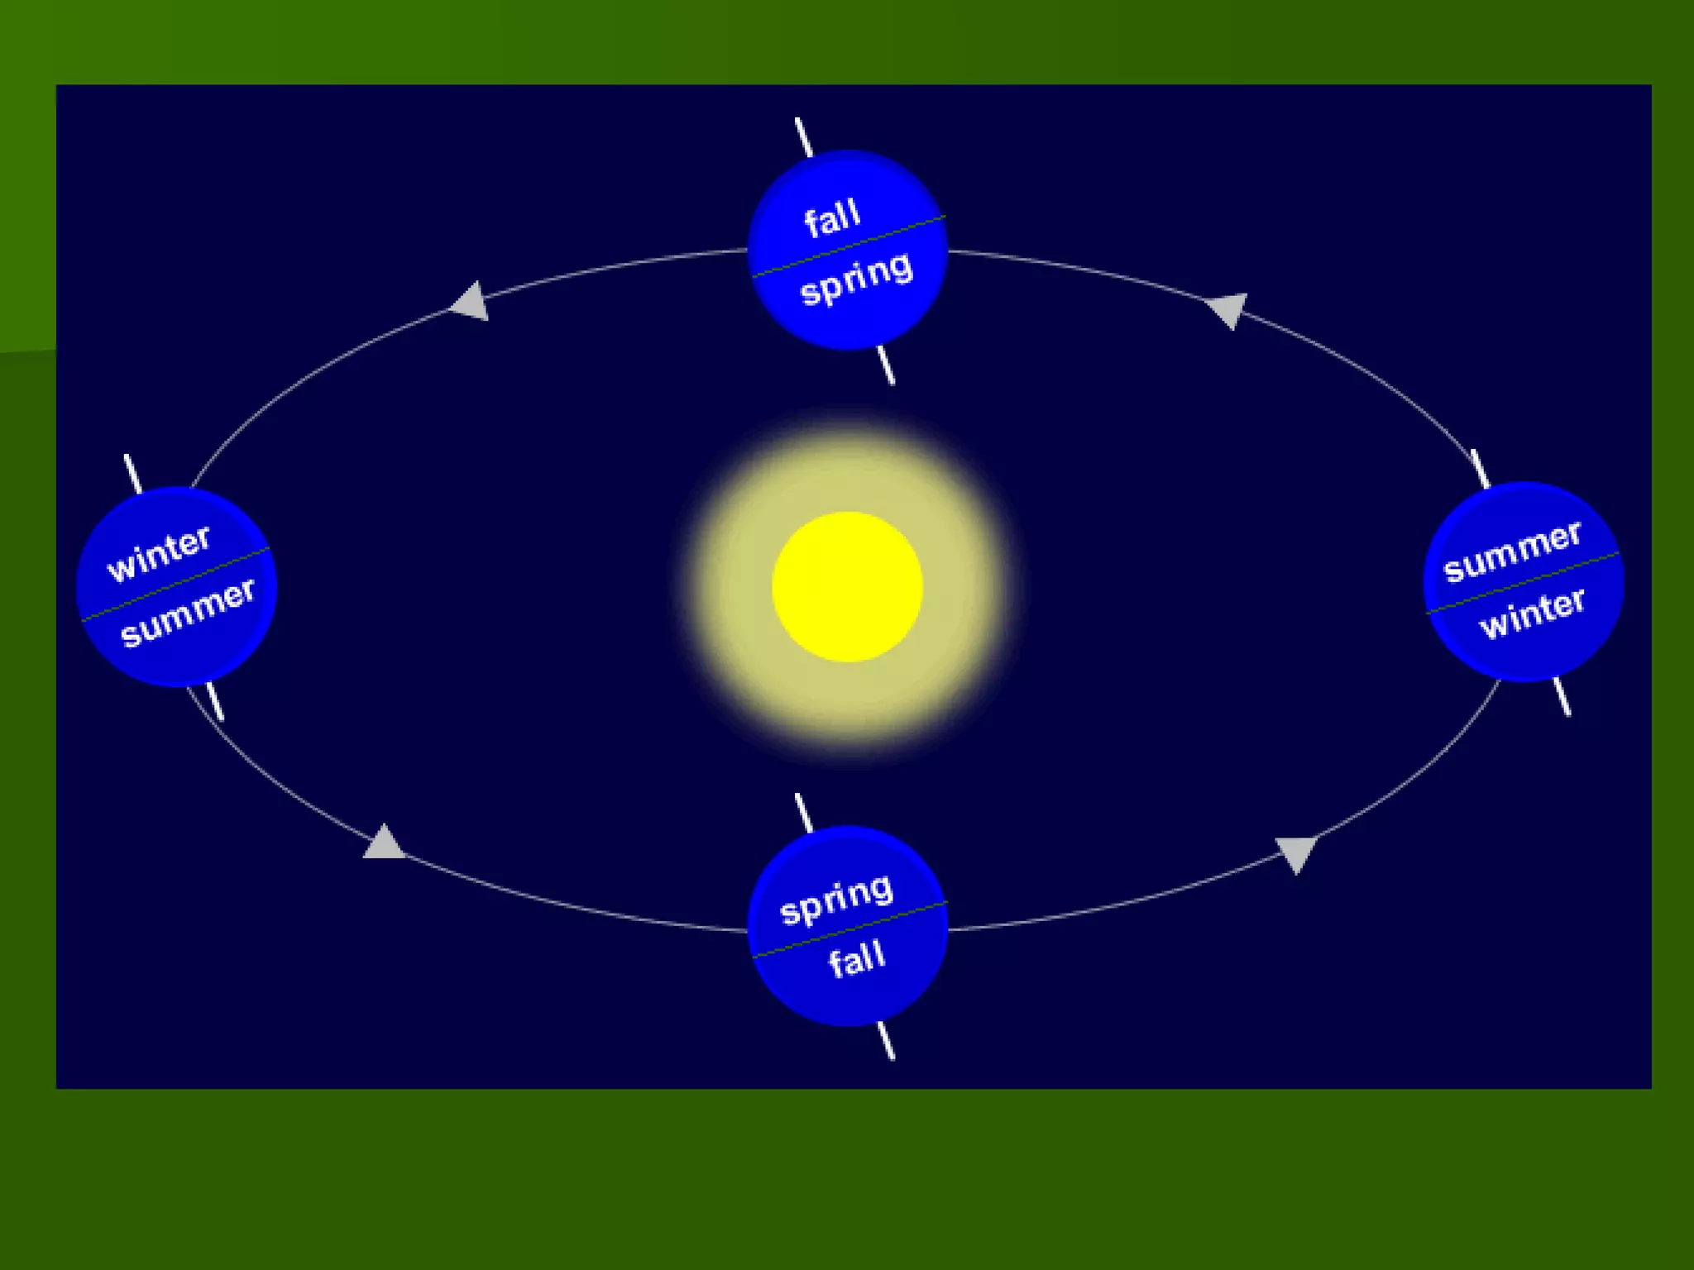
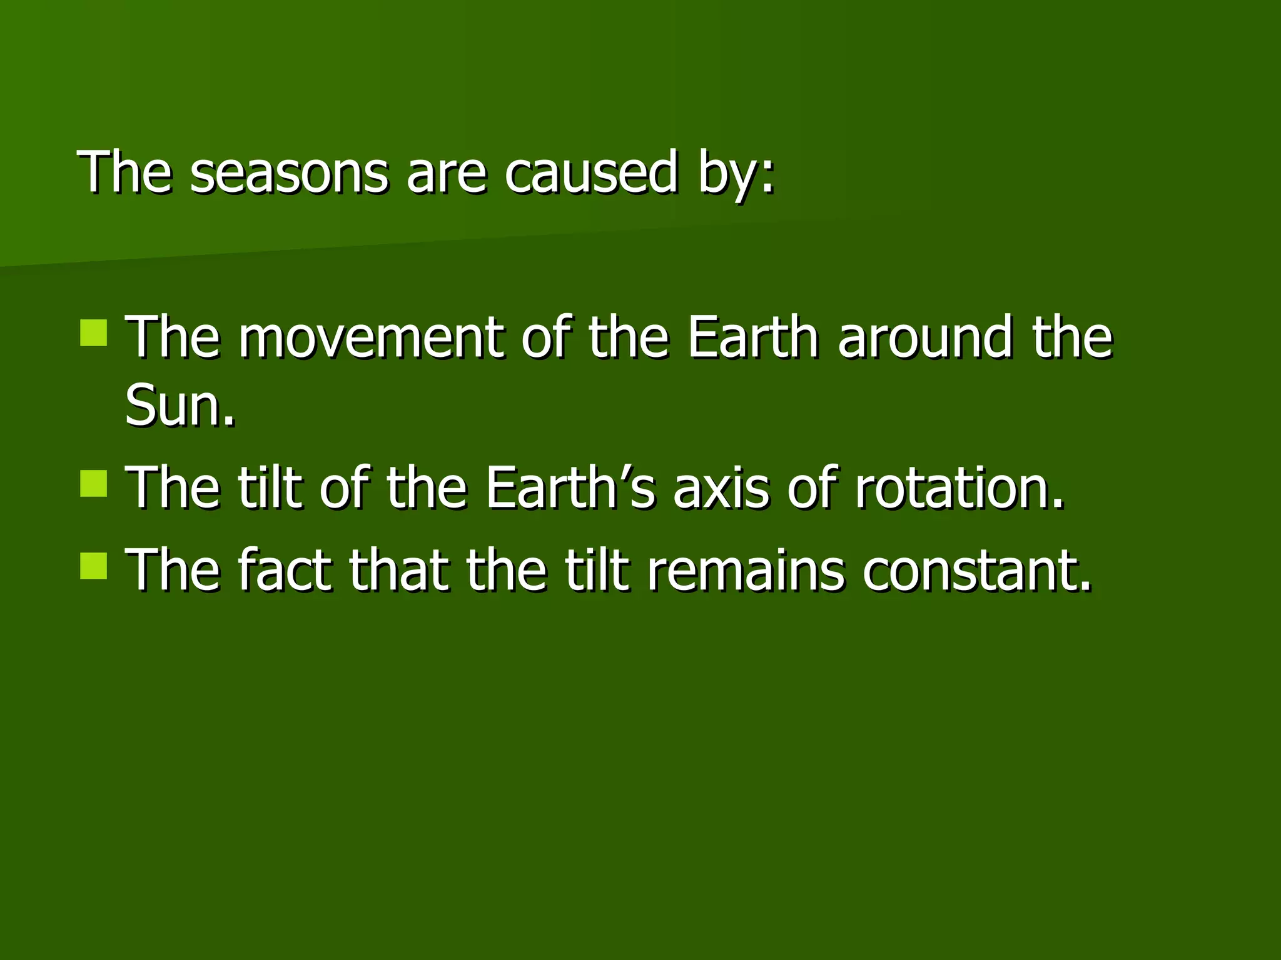
Movements of Earth/Social/NKarunambigai/SNS ACADEMY

Slide 13
MOVEMENTS OF EARTH
https://youtu.be/wYWgvkwCf8o

Slide 14
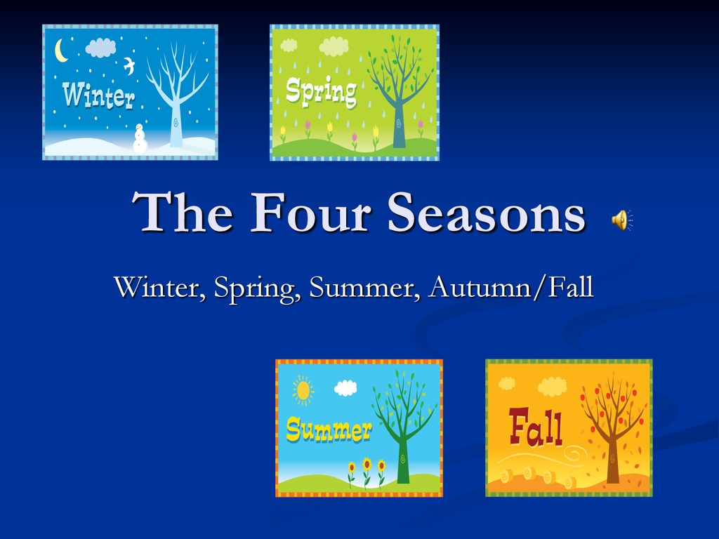
SEASONS

Slide 15
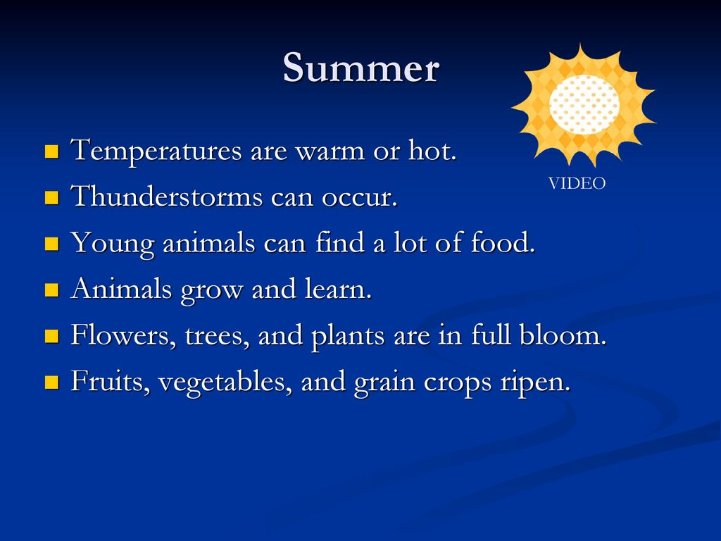
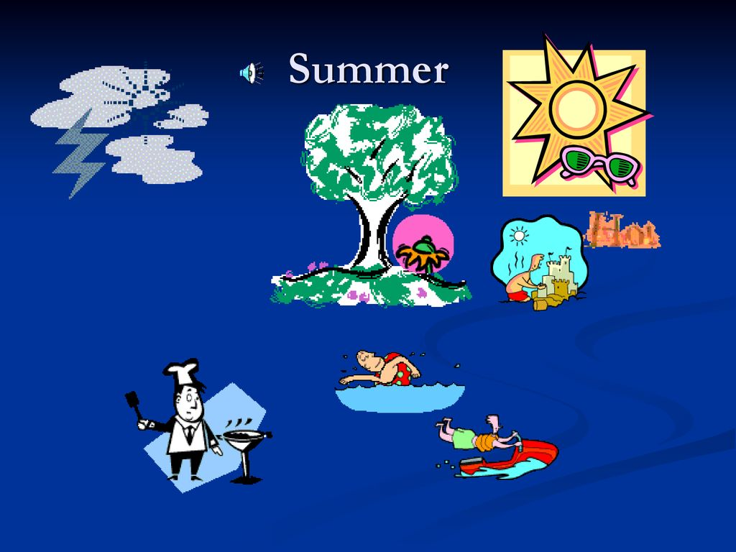
SUMMER

Slide 16
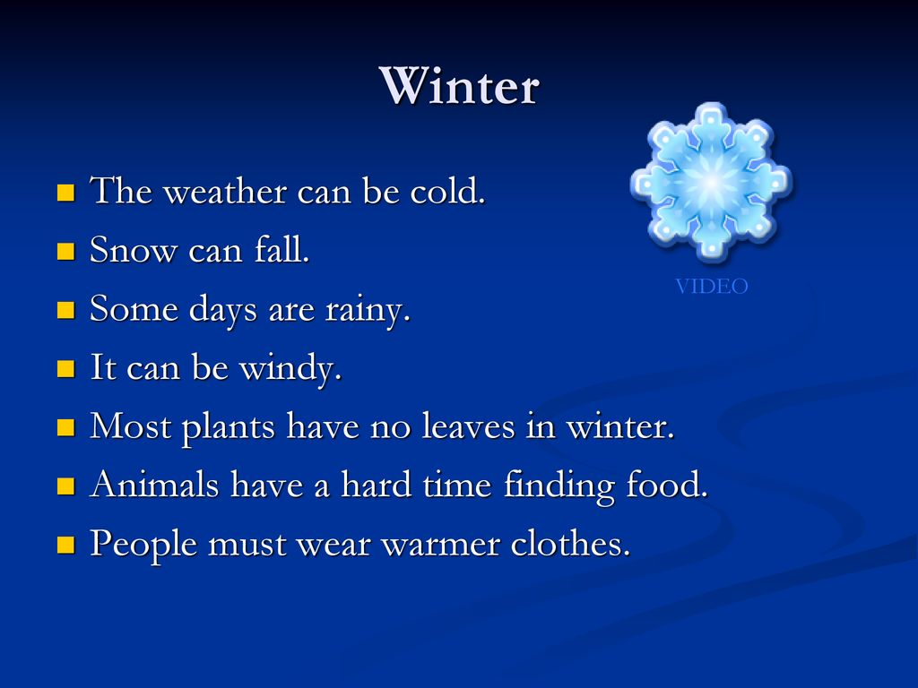
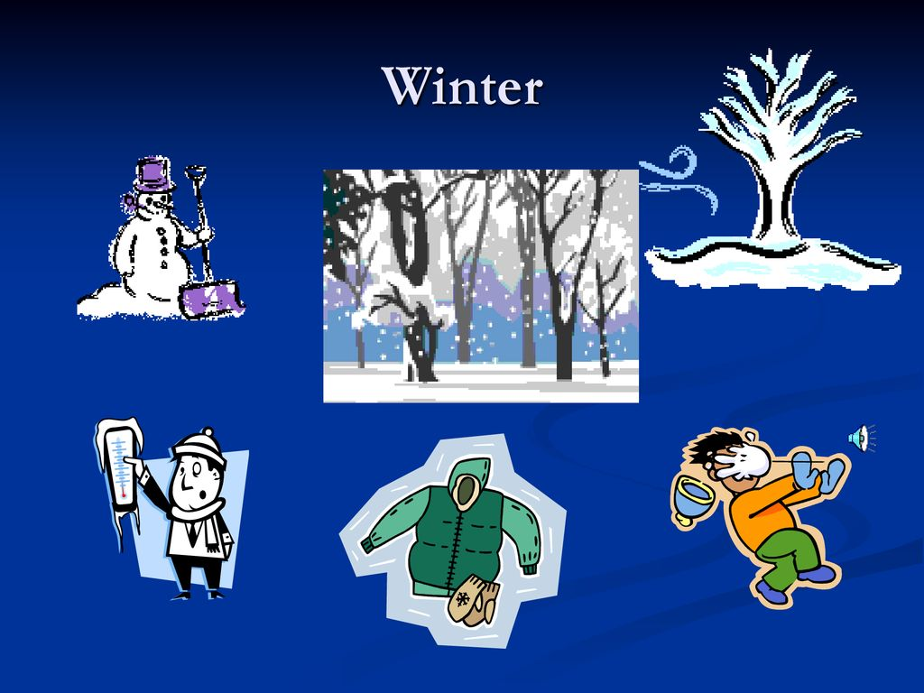
WINTER

Slide 17
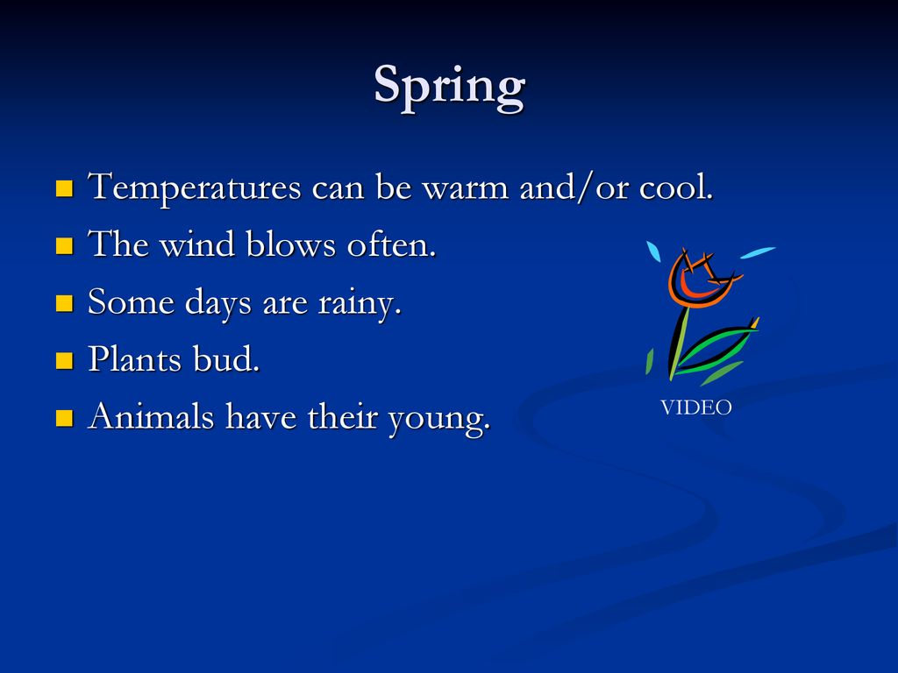
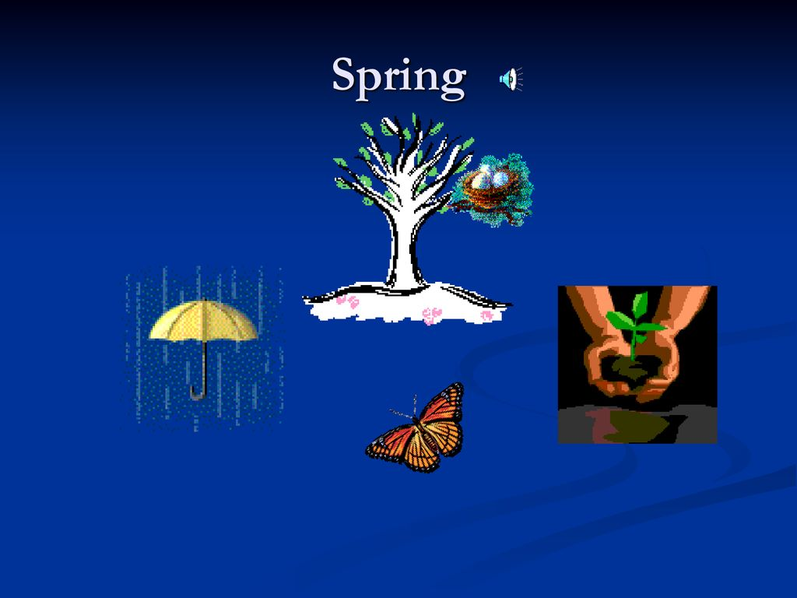
SPRING
Movements of Earth/Social/NKarunambigai/SNS ACADEMY

Slide 18
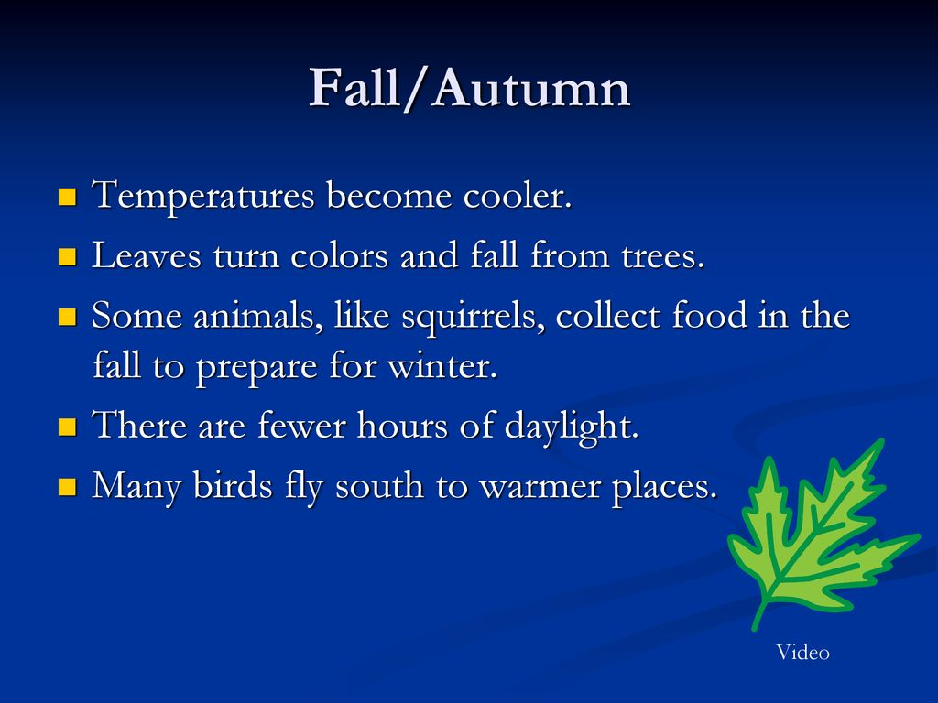

AUTUMN

Slide 19


